Slide 1

Working with Azure Cosmos DB in Azure Functions
Will Velida – Software Engineer – ASB Bank

Slide 2



About Me
Software Engineer at ASB Bank, working in the Payments Platform.
From UK, lived in NZ for about 9 years.
.NET, Azure Cosmos DB, Azure Functions, Event Hubs, Storage, Log Analytics etc. etc.

Slide 3
Agenda
What is Azure Cosmos DB?
How Cosmos DB and Azure Functions work together.
Demo.
Things to note when developing.
Q&A.

Slide 4



Azure Cosmos DB
A globally distributed, massively scalable, multi-model database service
SQL
MongoDB
Table API
Column-family
Document
Key-value
Graph
Guaranteed low latency at the 99th percentile
Elastic scale out
of storage & throughput
Five well-defined consistency models
Turnkey global distribution
Comprehensive SLAs

Slide 5
Why Azure Functions + Azure Cosmos DB?
Functions provide scalable units of work.
Don’t have to create a full app to work with Cosmos DB.
Build Event-driven apps that scale globally.

Slide 6
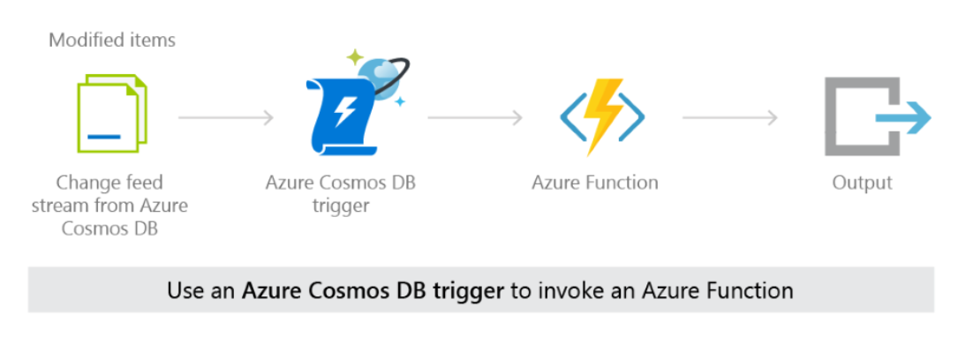
Event-driven Functions using Cosmos DB Change Feed. (Trigger)

Slide 7



Azure Cosmos DB Change Feed
Backup collection
Cold Storage
InsertProduct
Product Collection
ML Workloads

Slide 8
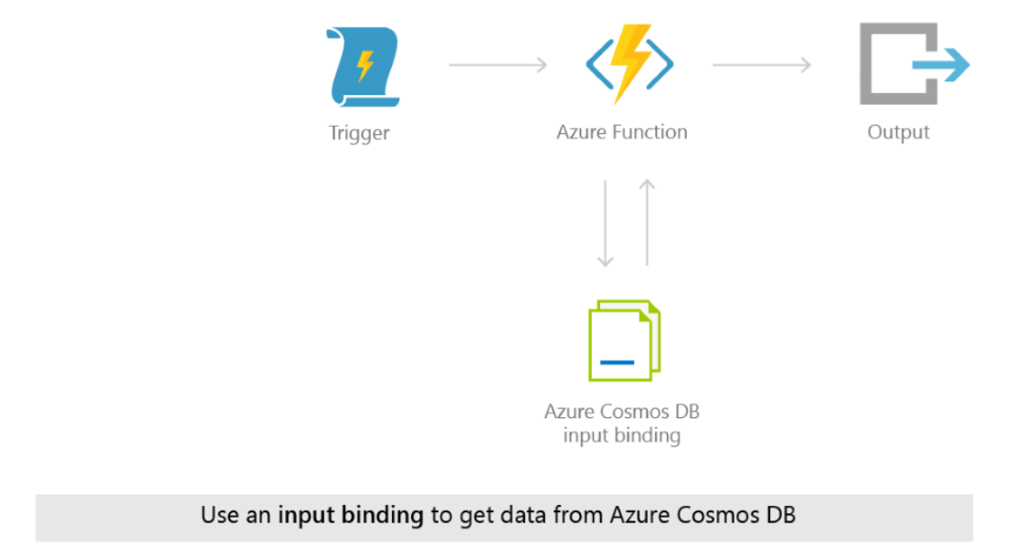
Read data from containers on Function Executions (Input Binding)

Slide 9
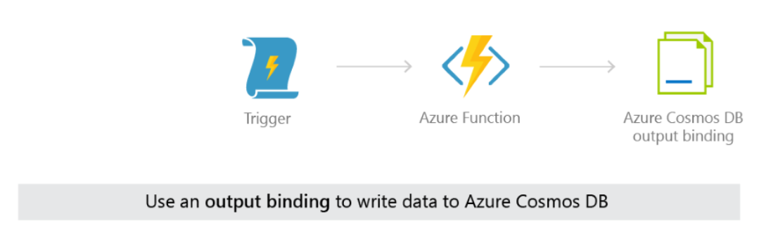
Write data to containers on Function execution (Output Binding)

Slide 10
Things to note
Bindings only support SQL API (Use static client for other APIs).
Each Binding initiates it’s own DocumentClient instance.
Bindings currently use the v2 .NET SDK, not v3

Slide 11
Dependency Injection support
Azure Functions support Dependency Injection (Starting from 2.0).
Built on .NET Core DI Features.
Same service lifetimes as ASP.NET Dependency Injection
Transient
Scoped
Singletons

Slide 12
Demo time!

Slide 13



Want to learn more?
Microsoft Learn.
Azure Functions Documentation.
Azure Cosmos DB Documentation.
Cosmos DB Deep Dive Labs.
25 Days of Serverless

Slide 14
Thanks for listening!
Twitter: @willvelida
Email: will.velida@asb.co.nz
LinkedIn: https://www.linkedin.com/in/willvelida/

